Slide 1


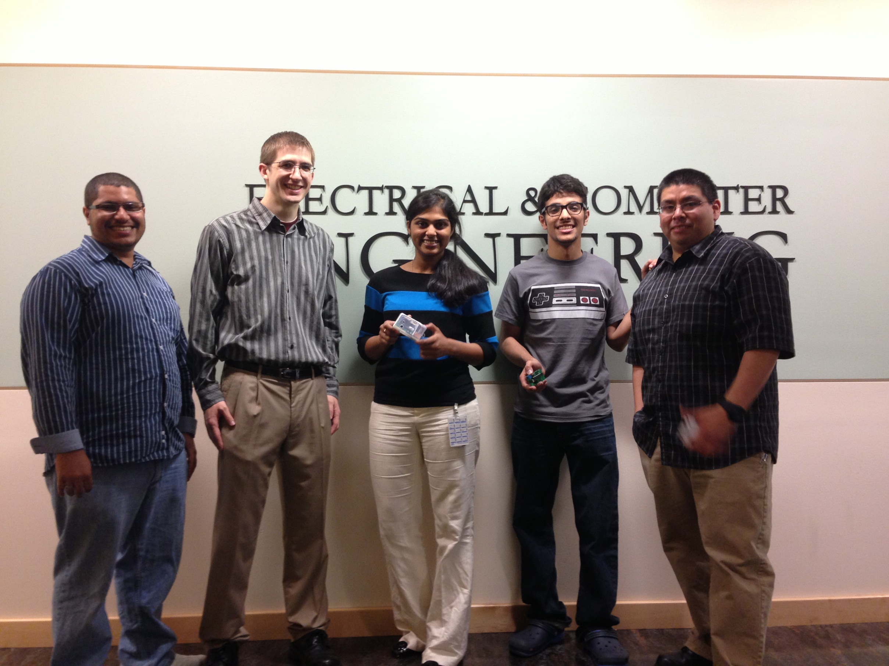
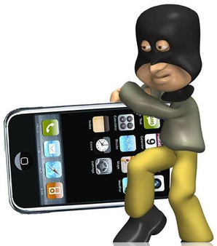
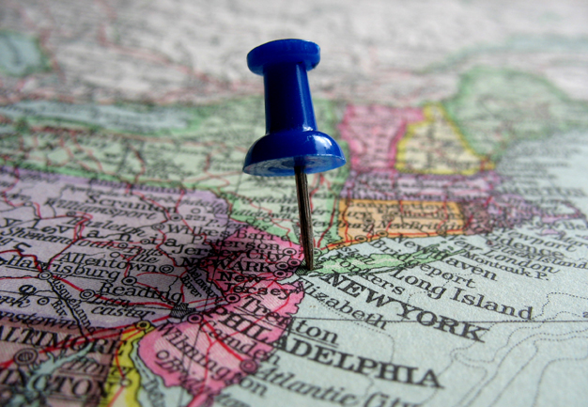
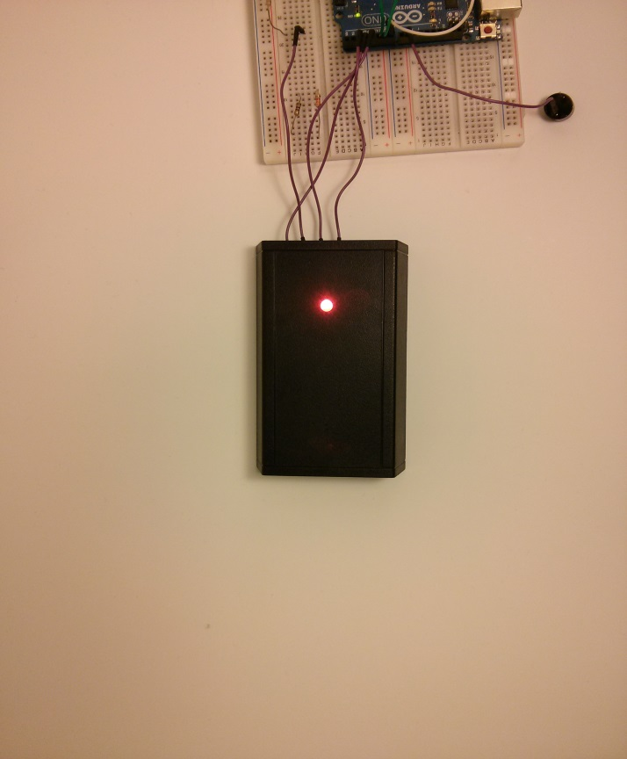



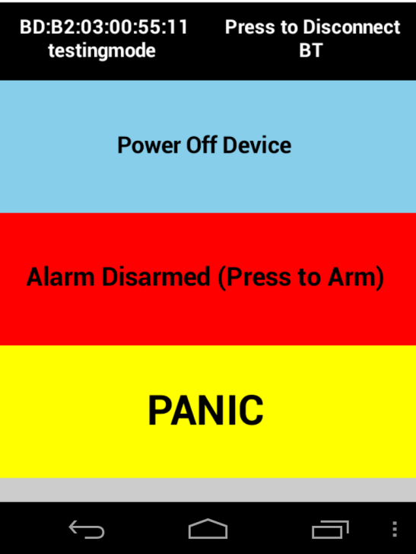
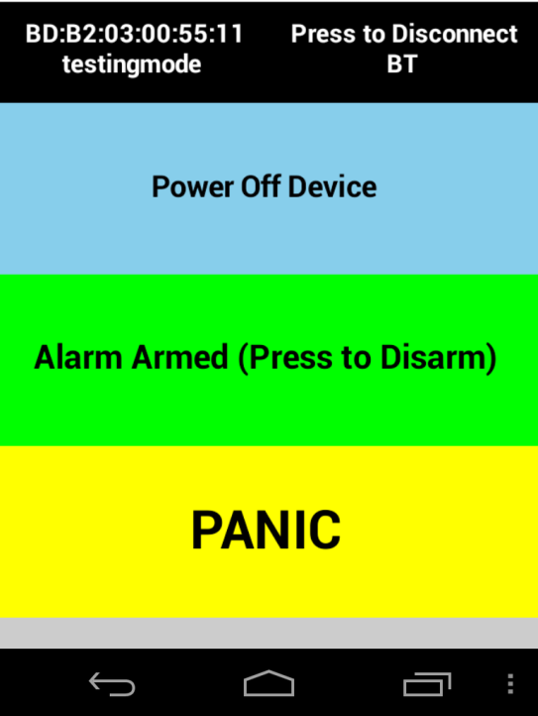
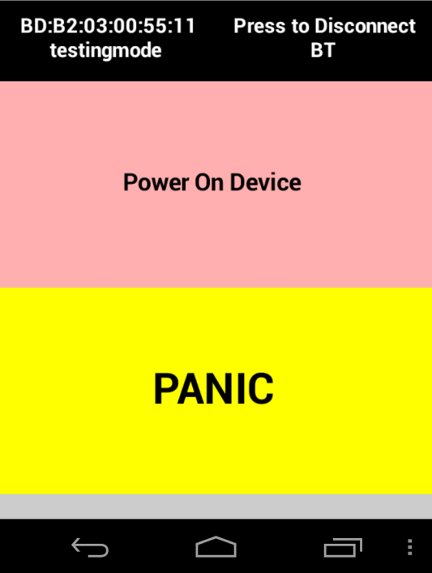

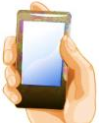
You Watch My Stuff
Team Members: Hussain Alsaffar, Richard Atwood, Amrutha Doosa, Raed Alkhaldi, Randy Duran
Sponsor: Chris Wilkerson
Adviser: Malgorzata Jeske
PROBLEM
HYPOTHETICAL VISION
Has this ever happened to you
The You watch my Stuff Project has Future plans in expanding the many feature possibilities. The Future objective of this Project will be to create a smaller, affordable and Interactive device such as the designs shown below
IMPLEMENTATION
The alarm device has a multicolor LED that Interacts with the user. Below is a chart of how the Alarm device Turns on the LED.
Features:
- Pedometer
- GPS Tracker
- Waterproof package
- Small package using surface mount components
- Close to Out of Range area cell phone notification
- Rechargeable batteries
-Alarm is Detecting Movement
- Alarm is ‘ON’ state
- Alarm is Activated
-Triggered Alarm (Blink .5 sec)
Theft is very common nowadays especially between college students. Today students can’t guarantee that their belongings will not be stolen while leaving it unattended. So?
IDEA
ANDROID APPLICATION
Then you need YWMSy!
The Alarm device is controlled via cell phone and the Pictures below shows Graphic User Interface that controlled the Alarm device. The application has buttons to ON/OFF, Enable/Disabled and Panic the Alarm Device
The Project You Watch My Stuff was Created and Sponsored by Chris Wilkerson from Intel. The Project is an Alarm Device that can be attached or placed on to any item you would like to secure. The Alarm Device is used in conjunction with a cell phone application. The phone application is used to turn “ON” the device and enable the Alarm.
Pen Design
Alarm Ball Design
GOALS
A security device that will alert the user and keep a thief from stealing your belongings is a necessity in these days.
DESIGN BLOCK DIAGRAM
- Bluetooth Type 2 Range is about 30ft /10m in sight
- User friendly Android GUI
- Secure Communication via Bluetooth
- Alarm Triggered when device is Moved
- Panic/Finder Enabled
Portable
Battery life time more then 12 hours and less than122 hours
ACKNOWLEDGEMENTS
We want to thank the following people for their support and feedback on Our Progress
Sponsor: Chris Wilkerson
Adviser: Malgorzata Jeske
Professor: Mark Faust
MCECS Department of Electrical and Computer Engineering

